Slide 1
Unit-V Exception Handling
Contents:-
Fundamentals of Exception Handling
Types of Exceptions
Keywords used in Exception handling
Multiple catch clauses
Nested try Statements
Java Built in Exceptions
User Defined Exceptions.
1

Slide 2
Exception Handling
Exception Handling:
An unexpected, unwanted event which disturbs the normal flow of the program is noting but exception.
Objective of Exception Handling: Graceful termination of program(We should not miss anything).
The exception handling in java is one of the powerful mechanism to handle the runtime errors so that normal flow of the application can be maintained.
Exception is abnormal termination of program due to breaking of fundamental rules of Java. Exception is an object of particular class which is subclass of RuntimeException.

Slide 3
Exception Handling
Exception Handling:
A Java exception is an object that describes an exceptional condition that has occurred in a piece of code.
When an exceptional condition arises, an object representing that exception is created and thrown in the method that caused the error.
Meaning of Exception: Defining alternative way to continue rest of the program normally is the concept of exception handling.
The core advantage of exception handling is to maintain the normal flow of the application. An exception normally disrupts the normal flow of the application that is why we use exception handling.

Slide 4
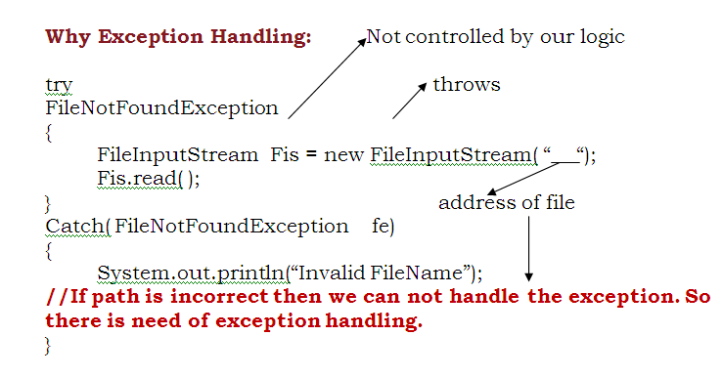
Exception Handling
Exception Handling:

Slide 5
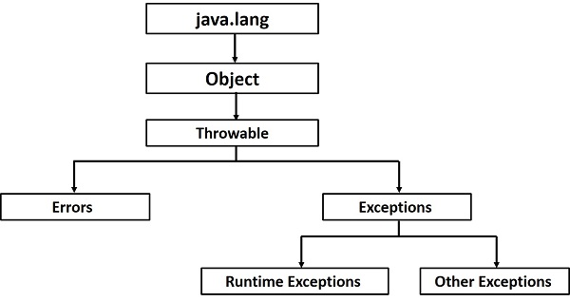
Exception Handling
Exception Hierarchy:

Slide 6
Exception Handling
Exception Handling:
Errors | Exceptions
Errors in java are of type java.lang.Error. | Exceptions in java are of type java.lang.Exception.
All errors in java are unchecked type. | Exceptions include both checked as well as unchecked type.
Errors happen at run time. They will not be known to compiler. | Checked exceptions are known to compiler where as unchecked exceptions are not known to compiler because they occur at run time.
It is impossible to recover from errors. | You can recover from exceptions by handling them through try-catch blocks.
Errors are mostly caused by the environment in which application is running. | Exceptions are mainly caused by the application itself.
Examples : java.lang.StackOverflowError, java.lang.OutOfMemoryError | Examples : Checked Exceptions : SQLException, IOException Unchecked Exceptions : ArrayIndexOutOfBoundException, ClassCastException, NullPointerException

Slide 7
Exception Handling
Exceptions can occur at many levels:
Hardware/Operating system level.
  Arithmetic exceptions; divide by 0, under/overflow.
  Memory access violations; segfault, stack over/underflow.
Language level.
  Type conversion; illegal values, improper casts.
  Bounds violations; illegal array indices.
  Bad references; null pointers.
Program level.
  User defined exceptions.

Slide 8
Exception Handling
Exceptions can be generated by the Java run-time system, or they can be manually generated by your code
Java exception handling is managed by five keywords: try, catch, throw, throws, and finally
Program statements which are error prone, put that code into try block.
If an exception occurs within the try block, it is thrown. Code within catch block will do the desired operation and handle it.
Sub class cannot throw more Exceptions than the super class.
If the method throwing an exception does not catch it , the method must declare that it throws that exception.

Slide 9
Exception Handling
Keywords in Exception
Keyword | Description
try | The "try" keyword is used to specify a block where we should place exception code. The try block must be followed by either catch or finally. It means, we can't use try block alone.
catch | The "catch" block is used to handle the exception. It must be preceded by try block which means we can't use catch block alone. It can be followed by finally block later.
finally | The "finally" block is used to execute the important code of the program. It is executed whether an exception is handled or not.
throw | The "throw" keyword is used to throw an exception.
throws | The "throws" keyword is used to declare exceptions. It doesn't throw an exception. It specifies that there may occur an exception in the method. It is always used with method signature.

Slide 10
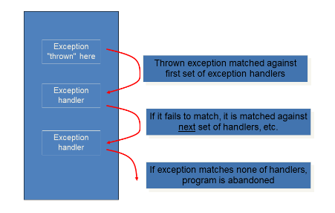
Exception Handling
Uncaught Exception:
When we don’t handle Exception in Java, it is passed to Java’s default Exception handler. This handler prints the description of Exception on the console and the program terminates on the same line. This abrupt termination of program leads user to the confusion. To avoid this we have to have Exception Handling code in program.
Code-1

Slide 11
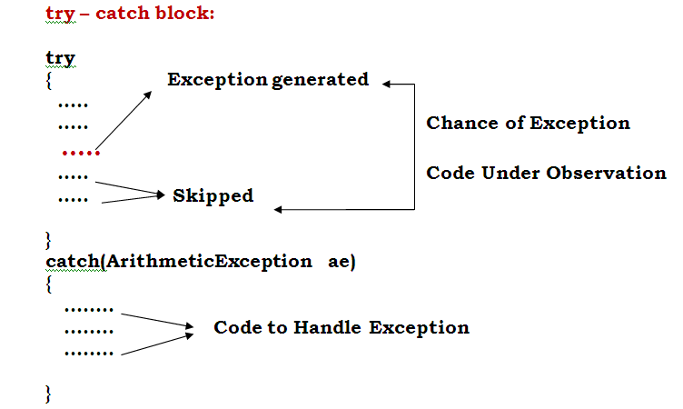
Exception Handling

Slide 12
Exception Handling
The code in which there are chances of Exception is put in try-block. The code in try- block is considered under monitoring. When an Exception is raised in try –block. The control of the program is passed to the catch block followed by try-block
The catch block accepts the object of corresponding Exception class and holds the code necessary to handle Exception. After execution of catch block, the code after catch is executed. The code in try block after exception is skipped because catch is never called from try.
Code-2

Slide 13
Exception Handling
Multiple Catch:
A code in which there are chances of multiple Exception can be put in a try block followed by multiple catch block. When an Exception is raised in try block, the control of the program is passed to all catch block sequentially and whenever exception object matches, the corresponding catch block is executed.
Code-3

Slide 14
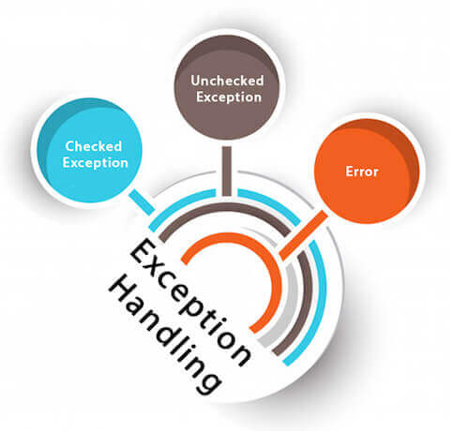
Exception Handling
Types of Java Exceptions:
There are mainly two types of exceptions: checked and unchecked. Here, an error is considered as the unchecked exception
1. Checked Exception
2. Unchecked Exception
Checked Exception
The classes which directly inherit Throwable
class except RuntimeException and Error
are known as checked exceptions e.g.
IOException, SQLException etc.
Checked exceptions are checked at compile-time.

Slide 15
Exception Handling
Types of Java Exceptions:
Unchecked Exception
The classes which inherit RuntimeException are known as unchecked exceptions e.g. ArithmeticException, NullPointerException, ArrayIndexOutOfBoundsException etc. Unchecked exceptions are not checked at compile-time, but they are checked at runtime.
Checked Exception | Unchecked Exception
ClassNotFoundException | ArithmeticException
IllegalAccessException | IndexOutOfBoundsException --ArrayIndexOutOfBoundsException --StringIndexOutOfBoundsException
NoSuchFieldException | NullPointerException
NoSuchMethodException | InputMismatchException
InterruptedException | EmptyStackException
IOException | IllegalArgumentException --NumberFormatException

Slide 16
Exception Handling
Checked Exception | Unchecked Exception
ClassNotFoundException | ArrayStoreException
IllegalAccessException | ClassCastException
NoSuchFieldException | NegativeArraySizeException
NoSuchMethodException | SecurityException.
InterruptedException, IOException
EOFException, FileNotFoundException
InterruptedIOException,
InvalidClassException, InvalidObjectException
SocketException, MalformedURLException
ProtocolException , UnknownHostException
SQLException , BatchUpdateException
SQLDataException

Slide 17
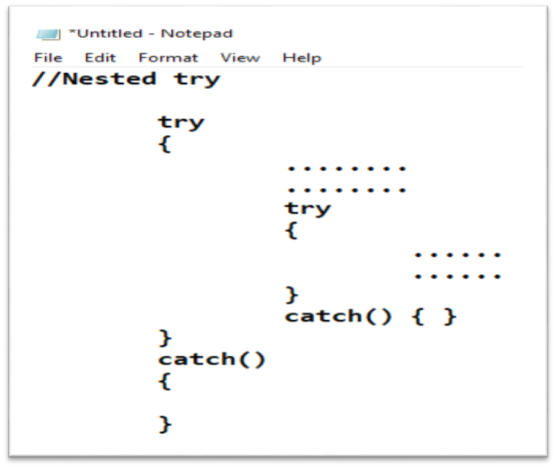
Exception Handling
Nested try:
In nested try block when an exception is raised in inner try, the control is the program is passed to the inner catch, but if inner catch cannot handle it, it is passed to outer catch for handling.
Code-4:

Slide 18
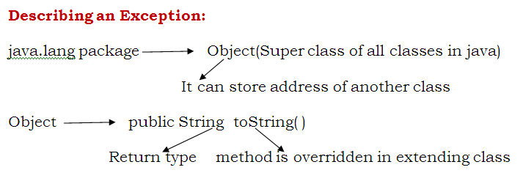
Exception Handling
Class ArithmeticException extends RuntimeException{
public String toString( ){
return”Java.lang.ArithmeticException:\ by zero”;
}
}
Code-5:

Slide 19
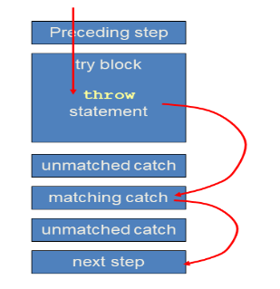
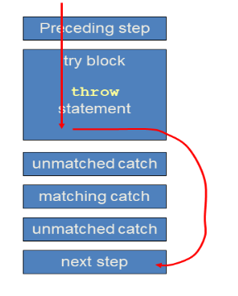
Exception Handling
throw” keyword: It is used to throw exception object explicitly
Sequence of events for throw: Sequence of events for throw:
When we rethrow an exception from a method it becomes an uncaught exception in a method. The person who wants to call this method should call it with proper try catch arrangement. Though this increases the responsibility of an user, it facilitates him with a freedom to take corresponding action on exception.
Code-6:

Slide 20
Exception Handling
To rethrow an exception using throw” keyword:
Code-7:
“throws” keyword:
This keyword is used to intimate the user about the uncaught exception in method. This
keyword is attached in method name followed by names of exception class.
For some exception it is compulsory to write throws clause. Such Exception are known as checked exception and other exceptions are known as unchecked exception.
Code-8:

Slide 21
Exception Handling
Throw VS Throws:
throw | throws
Java throw keyword is used to explicitly throw an exception. | Java throws keyword is used to declare an exception.
Checked exception cannot be propagated using throw only. | Checked exception can be propagated with throws.
Throw is followed by an instance. | Throws is followed by class.
Throw is used within the method. | Throws is used with the method signature.
You cannot throw multiple exceptions. | You can declare multiple exceptions e.g. public void method()throws IOException,SQLException.

Slide 22
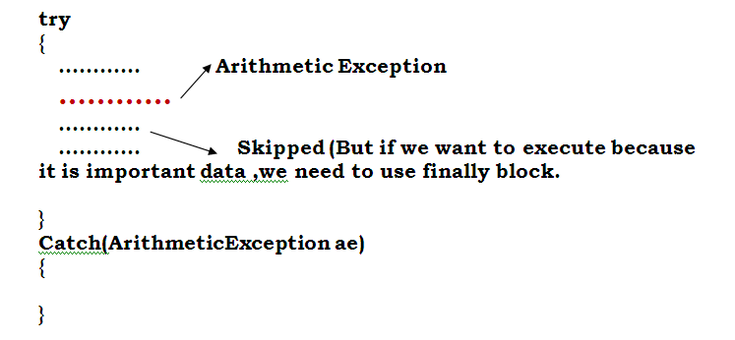
Exception Handling
Finally keyword:
If an exception is created in try block, the control of the program is passed to catch block following that try block. This skips the code in try block after exception.
But sometimes such code may contain some important logic which has to be executed in any situation(Input/Output, Closing of files, Database connection, socket). We put such code in finally block. The finally block is executed before passing control to catch block.

Slide 23
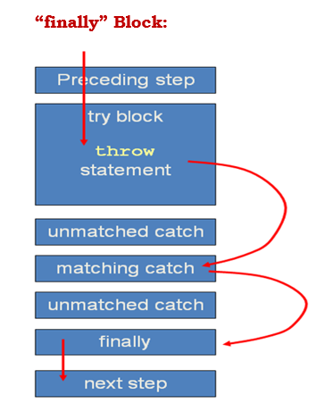
Exception Handling
Finally keyword:
Code-9:

Slide 24
Exception Handling
Creating User defined Exception:
Java provides us facility to create our own exceptions which are basically derived classes of Exception. The exceptions that are created by user are called as user defined exception.
Code-10:
Q1. Write an application that will accept age from user and find whether it is greater than 18 or not. If it is less than 18 generate an user defined exception “Not Eligible for Voting”.
Code-11:
Q2.Write an application that will accept name from employee and find whether it is valid employee , if valid then show appropriate message otherwise generate an user defined exception “Exception: NameIsInvalid”.
Code-12:
Q3. Write a class Driver with attributes vehicle no, name & age. Initialize values through parameterized constructor. If age of driver is less than 18 then generate user-defined exception “AgeNotWithinTheRange”.
Code-13:

Slide 25
Exception Handling
Creating User defined Exception:
Q4. Write a java program to accept name from user. If the name contains a non-alphabetical character, raise an Exception “InvalidNameException.
Code-14:

